Slide 1
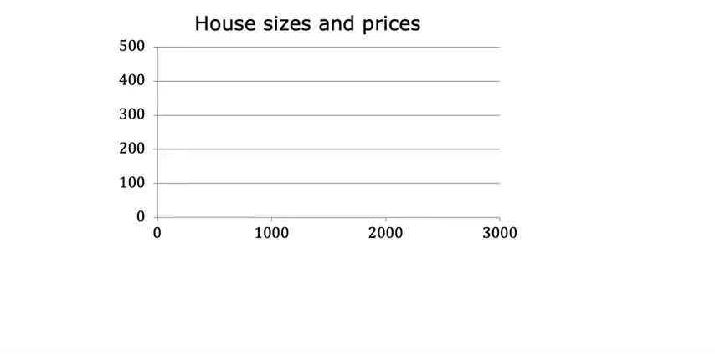

Slide 2
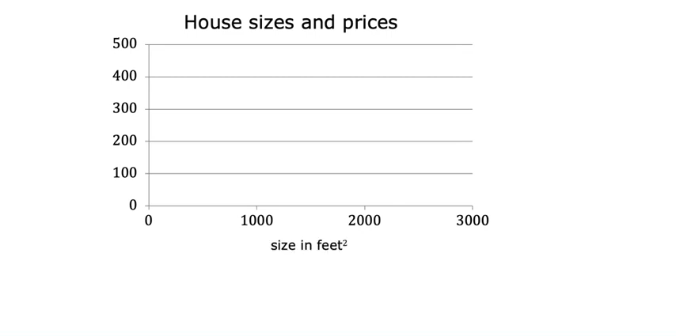

Slide 3
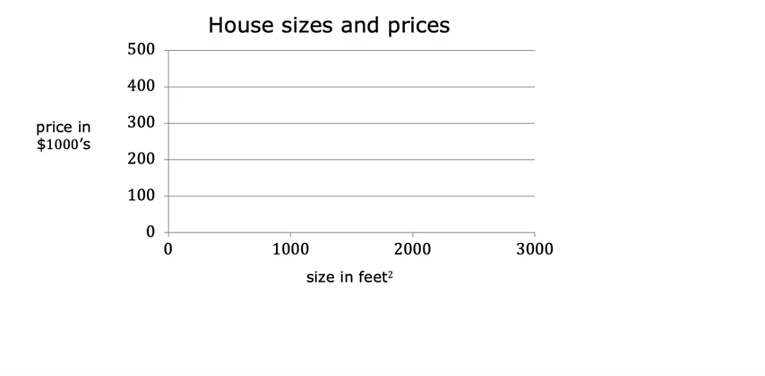

Slide 4
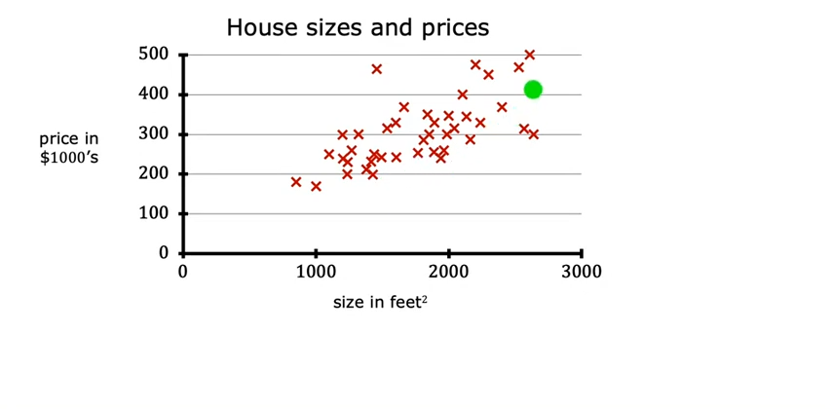

Slide 5
1250

Slide 6
Linear Regression
1250

Slide 7
Linear Regression
1250

Slide 8
Linear Regression
1250

Slide 9
Linear Regression
220K
1250

Slide 10
Linear Regression
220K
1250
Supervised Learning Model

Slide 11
Linear Regression
220K
1250
Supervised Learning Model
Data has “Right Answers”

Slide 12
Linear Regression
220K
1250
Regression Model
Predicts “numbers”
Supervised Learning Model
Data has “Right Answers”

Slide 13
Linear Regression
220K
1250
1.5, 0
Regression Model
Predicts “numbers”
Supervised Learning Model
Data has “Right Answers”

Slide 14
Linear Regression
220K
1250
1.5, 0
Regression Model
Predicts “numbers”
Supervised Learning Model
Data has “Right Answers”
Classification Model

Slide 15
Linear Regression
220K
1250
1.5, 0
Regression Model
Predicts “numbers”
Supervised Learning Model
Data has “Right Answers”
Classification Model
Predicts “categories”

Slide 16
Categories
cat
dog
Linear Regression
220K
1250
1.5, 0
Regression Model
Predicts “numbers”
Supervised Learning Model
Data has “Right Answers”
Classification Model
Predicts “categories”

Slide 17
Categories
cat
dog
Linear Regression
220K
disease
1250
1.5, 0
Regression Model
Predicts “numbers”
Supervised Learning Model
Data has “Right Answers”
Classification Model
Predicts “categories”

Slide 18
Categories
cat
dog
Linear Regression
2
220K
disease
10
1250
1.5, 0
Regression Model
Predicts “numbers”
Supervised Learning Model
Data has “Right Answers”
Classification Model
Predicts “categories”

Slide 19
Categories
cat
dog
Linear Regression
2
220K
disease
10
1250
1.5, 0
Regression Model
Predicts “numbers”
Supervised Learning Model
Data has “Right Answers”
Classification Model
Predicts “categories”
Small number of
possible Outputs

Slide 20
Categories
cat
dog
Linear Regression
2
220K
disease
10
1250
1.5, 0
Regression Model
Predicts “numbers”
Supervised Learning Model
Data has “Right Answers”
Classification Model
Predicts “categories”
Infinitely many
possible Outputs
Small number of
possible Outputs

Slide 21
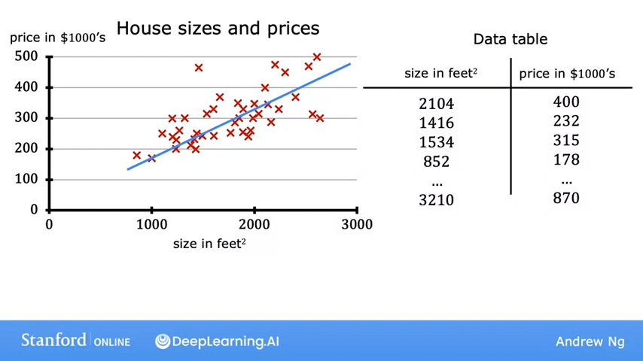

Slide 24
2104

Slide 25
400
2104

Slide 26
400
2104

Slide 27


Slide 28
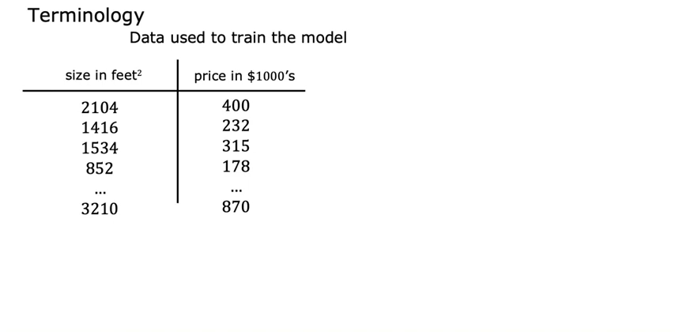

Slide 29
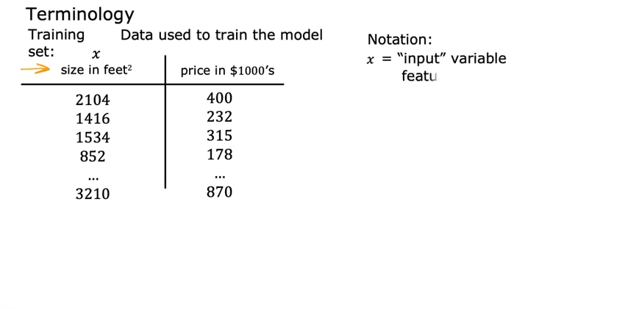

Slide 30
x = 2104

Slide 31
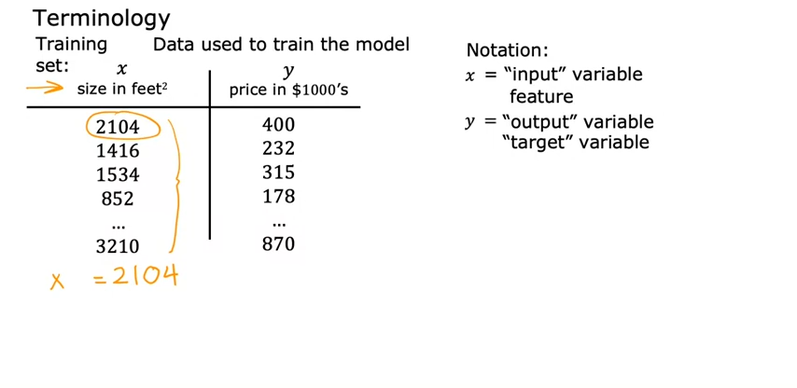
x = 2104 y=400

Slide 32
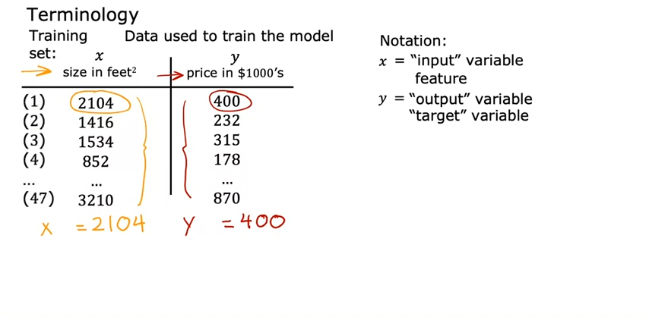
x = 2104 y=400

Slide 33
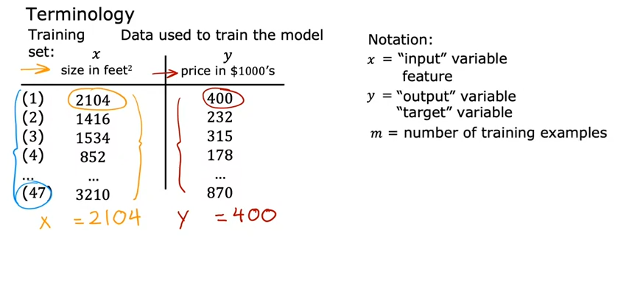
m = 47
x = 2104 y=400

Slide 34
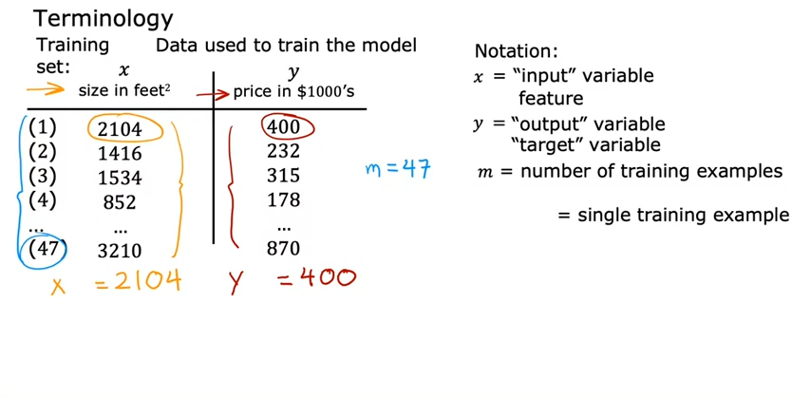
m = 47
(x , y)
x = 2104 y=400

Slide 35
m = 47
(x , y)
x = 2104 y=400
(x , y) = (2104 , 400)

Slide 36
m = 47
(x , y)
x = 2104 y=400
(x , y) = (2104 , 400)
(x^{(i)} , y^{(i)}) = (2104 , 400)

Slide 37
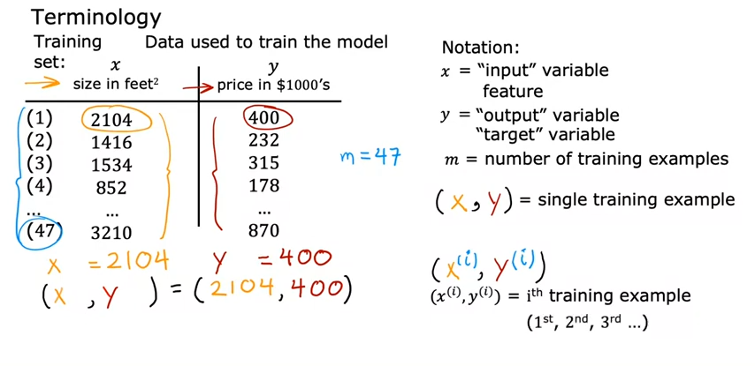
m = 47
(x , y)
x⁽¹⁾ = 2104 y⁽¹⁾=400
(x⁽¹⁾ , y⁽¹⁾) = (2104 , 400)
(x^{(i)} , y^{(i)}) = (2104 , 400)

Slide 38
m = 47
(x , y)
x⁽¹⁾ = 2104 y⁽¹⁾=400
(x⁽¹⁾ , y⁽¹⁾) = (2104 , 400)
(x^{(i)} , y^{(i)}) = (2104 , 400)
x⁽²⁾ = 1416

Slide 39
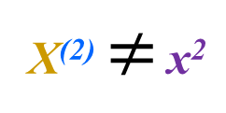
m = 47
(x , y)
x⁽¹⁾ = 2104 y⁽¹⁾=400
(x⁽¹⁾ , y⁽¹⁾) = (2104 , 400)
(x^{(i)} , y^{(i)}) = (2104 , 400)
X⁽²⁾ $≠$ x²
x⁽²⁾ = 1416
NOT EXPONENT

Slide 40
Linear Regression – Hypothesis

Slide 41
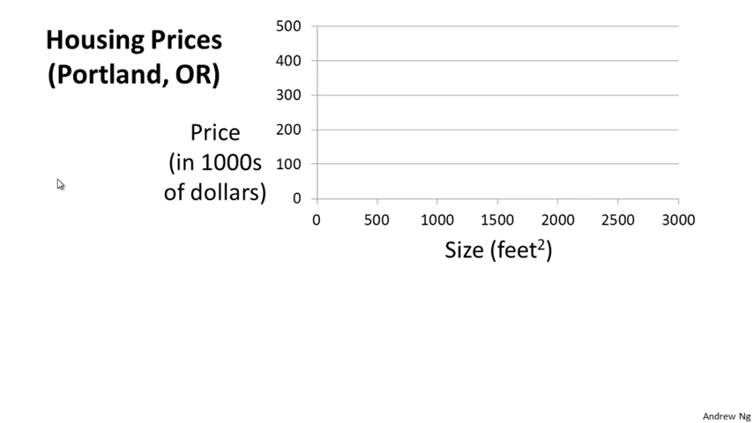

Slide 42
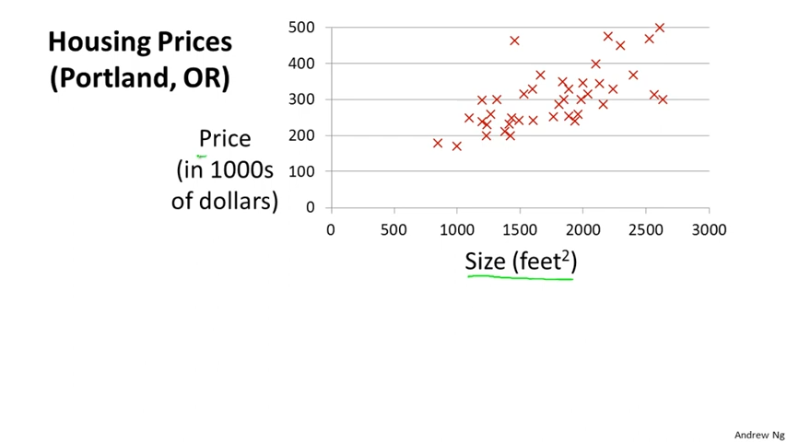

Slide 43
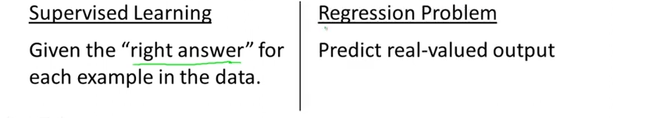

Slide 44
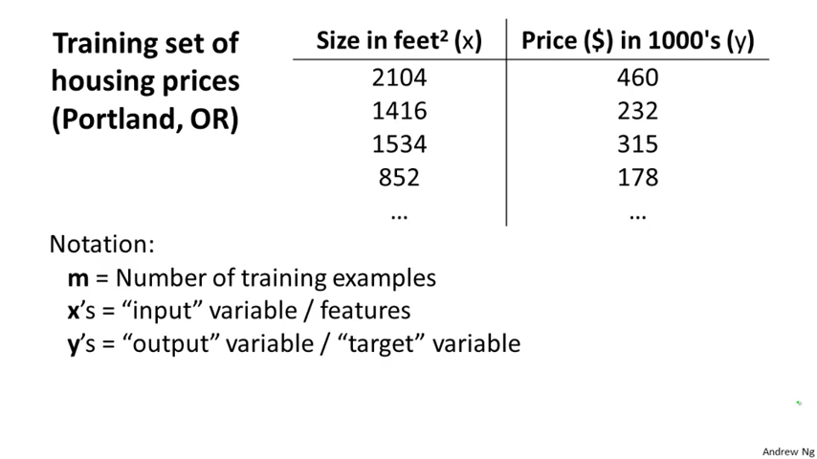

Slide 45
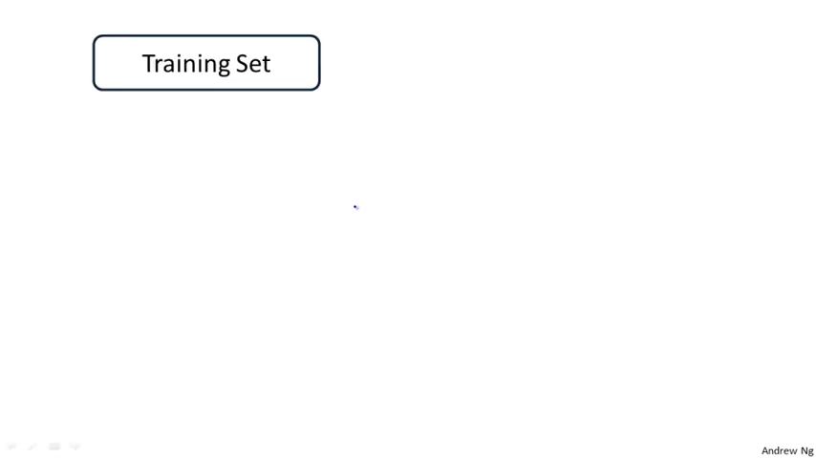

Slide 46
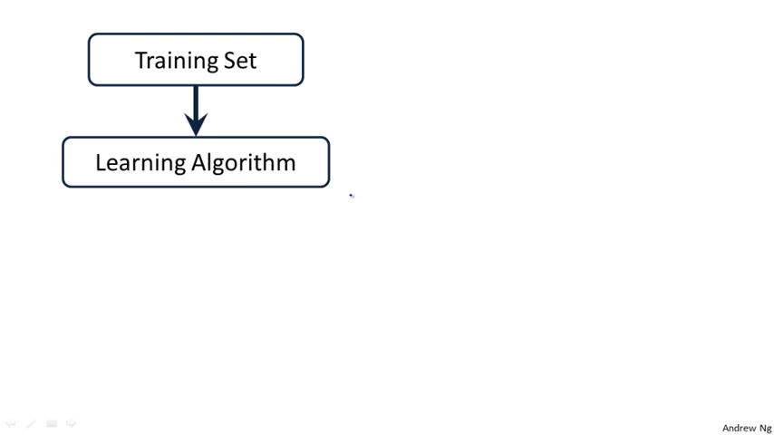

Slide 47
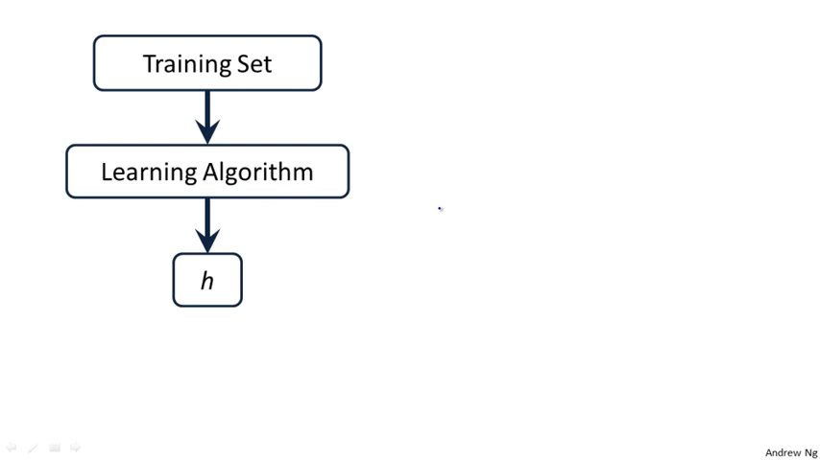

Slide 48
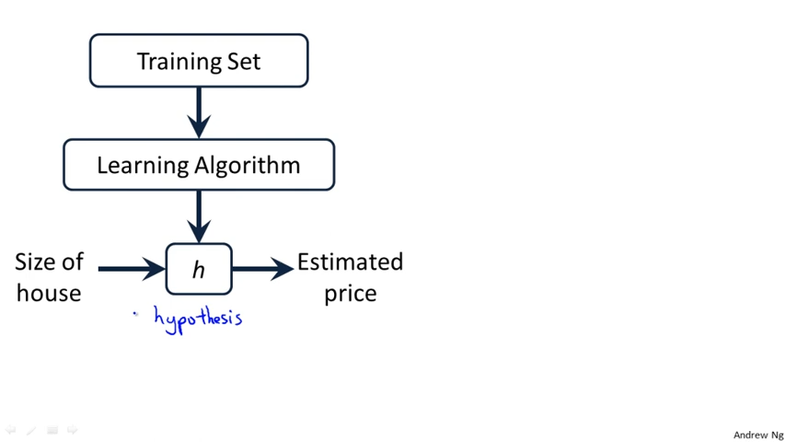
Hypothesis

Slide 49
x Hypothesis y_estimated
h maps from x’s to y’s

Slide 50
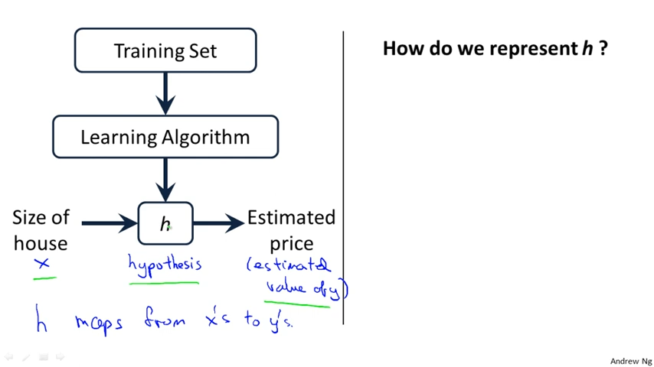
x Hypothesis y_estimated
h maps from x’s to y’s

Slide 51

$$h_{θ}\left(x\right)=θ_{0}+θ_{1}x$$
x Hypothesis y_estimated
h maps from x’s to y’s

Slide 52
$$h_{θ}\left(x\right)=θ_{0}+θ_{1}x$$
x Hypothesis y_estimated
h maps from x’s to y’s

Slide 53
$$h_{θ}\left(x\right)=θ_{0}+θ_{1}x$$
x Hypothesis y_estimated
h maps from x’s to y’s
Linear regression with one variable.
Univariate linear regression

Slide 54
Linear Regression – Cost function

Slide 55
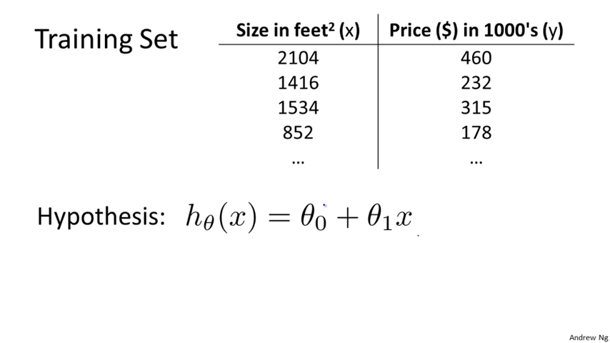

Slide 56
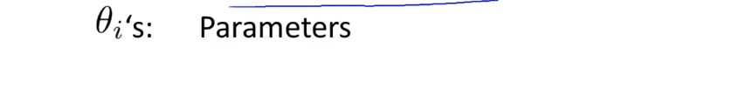

Slide 57
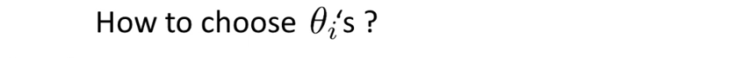

Slide 58
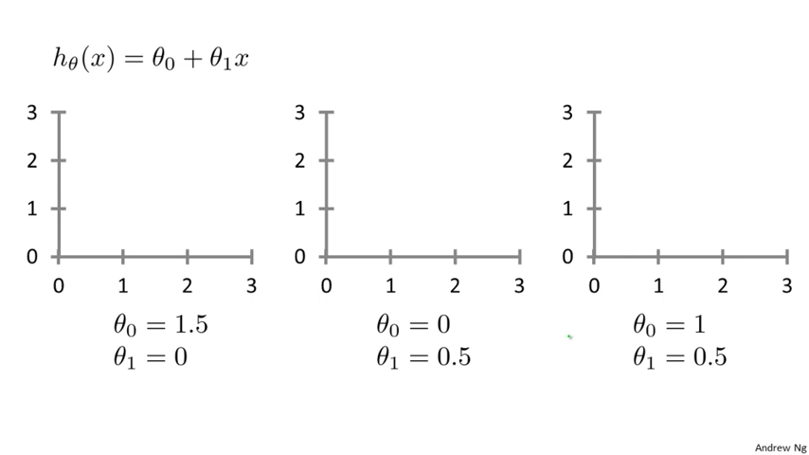

Slide 59

$$h\left(x\right)=1.5+0.x$$

Slide 60

$$h\left(x\right)=1.5+0.x$$
$$h\left(x\right)=0.5x$$

Slide 61

$$h\left(x\right)=1.5+0.x$$
$$h\left(x\right)=0.5x$$
$$h\left(x\right)=1+0.5x$$

Slide 62
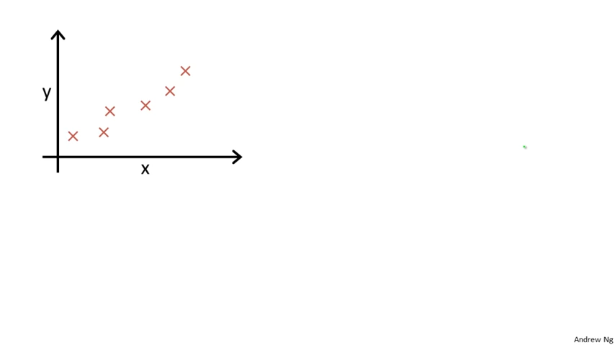

Slide 63
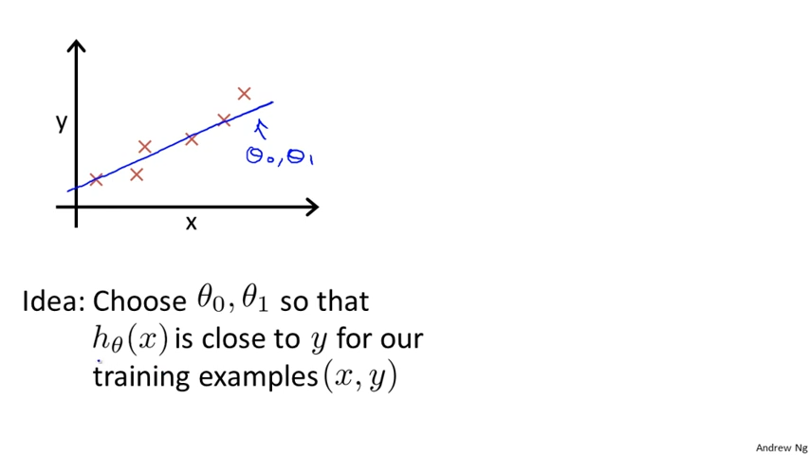

Slide 64
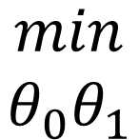
$$\begin{matrix}min \\ θ_{0}θ_{1}\end{matrix}$$

Slide 65
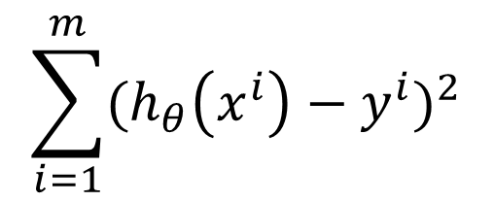
$$\sum_{i=1}^{m}{{(h_{θ}\left(x^{i}\right)−y^{i})}^{2}}$$
$$\begin{matrix}min \\ θ_{0}θ_{1}\end{matrix}$$

Slide 66
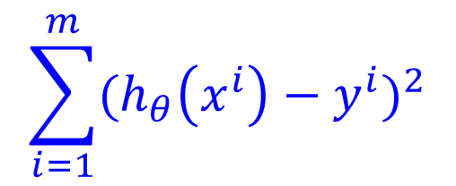
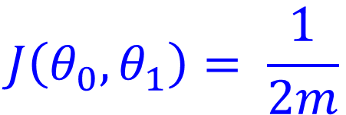

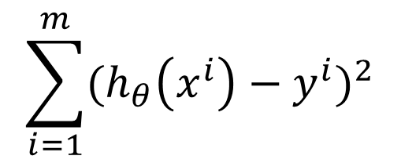
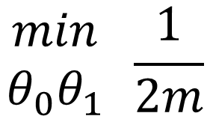
$$\sum_{i=1}^{m}{{(h_{θ}\left(x^{i}\right)−y^{i})}^{2}}$$
$$\begin{matrix}min \\ θ_{0}θ_{1}\end{matrix} \frac{1}{2m}$$
$$h\left(x^{i}\right)=θ_{0}+θ_{1}x$$
$$\sum_{i=1}^{m}{{(h_{θ}\left(x^{i}\right)−y^{i})}^{2}}$$
$$J\left(θ_{0},θ_{1}\right)= \frac{1}{2m}$$

Slide 67

$$\sum_{i=1}^{m}{{(h_{θ}\left(x^{i}\right)−y^{i})}^{2}}$$
$$\begin{matrix}min \\ θ_{0}θ_{1}\end{matrix} \frac{1}{2m}$$
$$h\left(x^{i}\right)=θ_{0}+θ_{1}x^{i}$$
$$\sum_{i=1}^{m}{{(h_{θ}\left(x^{i}\right)−y^{i})}^{2}}$$
$$J\left(θ_{0},θ_{1}\right)= \frac{1}{2m}$$

Slide 68
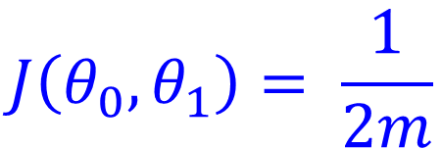





Hypothesis:
$$h\left(x\right)=θ_{0}+θ_{1}x$$
Parameters:
$$θ_{0}, θ_{1}$$
$$\sum_{i=1}^{m}{{(h_{θ}\left(x^{i}\right)−y^{i})}^{2}}$$
$$J\left(θ_{0},θ_{1}\right)= \frac{1}{2m}$$
Cost Function:
Goal:
minimize
$$J\left(θ_{0},θ_{1}\right)$$
$$\left(θ_{0},θ_{1}\right)$$

Slide 69




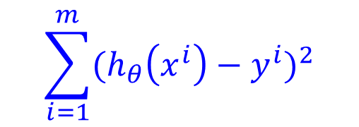
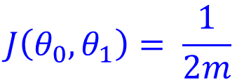
Simplified
Hypothesis:
$$h\left(x\right)=θ_{0}+θ_{1}x$$
Parameters:
$$θ_{0}, θ_{1}$$
$$\sum_{i=1}^{m}{{(h_{θ}\left(x^{i}\right)−y^{i})}^{2}}$$
$$J\left(θ_{0},θ_{1}\right)= \frac{1}{2m}$$
Cost Function:
Goal:
minimize
$$J\left(θ_{0},θ_{1}\right)$$
$$\left(θ_{0},θ_{1}\right)$$

Slide 70


Simplified
Hypothesis:
$$h\left(x\right)=θ_{0}+θ_{1}x$$
$$h\left(x\right)=θ_{0}+θ_{1}x$$
$$θ_{0}=0$$
Parameters:
$$θ_{0}, θ_{1}$$
$$\sum_{i=1}^{m}{{(h_{θ}\left(x^{i}\right)−y^{i})}^{2}}$$
$$J\left(θ_{0},θ_{1}\right)= \frac{1}{2m}$$
Cost Function:
Goal:
minimize
$$J\left(θ_{0},θ_{1}\right)$$
$$\left(θ_{0},θ_{1}\right)$$

Slide 71

Simplified
Hypothesis:
$$h\left(x\right)=θ_{0}+θ_{1}x$$
$$h\left(x\right)=θ_{0}+θ_{1}x$$
$$θ_{0}=0$$
Parameters:
$$θ_{0}, θ_{1}$$
$$h\left(x\right)=θ_{1}x$$
$$\sum_{i=1}^{m}{{(h_{θ}\left(x^{i}\right)−y^{i})}^{2}}$$
$$J\left(θ_{0},θ_{1}\right)= \frac{1}{2m}$$
Cost Function:
Goal:
minimize
$$J\left(θ_{0},θ_{1}\right)$$
$$\left(θ_{0},θ_{1}\right)$$

Slide 72

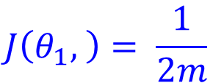

Simplified
Hypothesis:
$$h\left(x\right)=θ_{0}+θ_{1}x$$
$$h\left(x\right)=θ_{0}+θ_{1}x$$
$$θ_{0}=0$$
Parameters:
$$θ_{0}, θ_{1}$$
$$h\left(x\right)=θ_{1}x$$
$$\sum_{i=1}^{m}{{(h_{θ}\left(x^{i}\right)−y^{i})}^{2}}$$
$$J\left(θ_{0},θ_{1}\right)= \frac{1}{2m}$$
Cost Function:
$$\sum_{i=1}^{m}{{(h_{θ}\left(x^{i}\right)−y^{i})}^{2}}$$
$$J\left(θ_{1}, \right)= \frac{1}{2m}$$
Goal:
minimize
$$J\left(θ_{0},θ_{1}\right)$$
$$\left(θ_{0},θ_{1}\right)$$

Slide 73


Simplified
Hypothesis:
$$h\left(x\right)=θ_{0}+θ_{1}x$$
$$h\left(x\right)=θ_{0}+θ_{1}x$$
$$θ_{0}=0$$
Parameters:
$$θ_{0}, θ_{1}$$
$$h\left(x\right)=θ_{1}x$$
$$\sum_{i=1}^{m}{{(h_{θ}\left(x^{i}\right)−y^{i})}^{2}}$$
$$J\left(θ_{0},θ_{1}\right)= \frac{1}{2m}$$
Cost Function:
$$\sum_{i=1}^{m}{{(h_{θ}\left(x^{i}\right)−y^{i})}^{2}}$$
$$J\left(θ_{1}, \right)= \frac{1}{2m}$$
Goal:
minimize
$$J\left(θ_{0},θ_{1}\right)$$
minimize
$$J\left(θ_{1}\right)$$
$$\left(θ_{0},θ_{1}\right)$$
$$\left(θ_{1}\right)$$

Slide 74

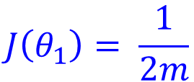





Simplified
Hypothesis:
$$h\left(x\right)=θ_{0}+θ_{1}x$$
$$h\left(x\right)=θ_{0}+θ_{1}x$$
$$θ_{0}=0$$
Parameters:
$$θ_{0}, θ_{1}$$
$$h\left(x\right)=θ_{1}x$$
$$\sum_{i=1}^{m}{{(h_{θ}\left(x^{i}\right)−y^{i})}^{2}}$$
$$J\left(θ_{0},θ_{1}\right)= \frac{1}{2m}$$
Cost Function:
$$\sum_{i=1}^{m}{{(h_{θ}\left(x^{i}\right)−y^{i})}^{2}}$$
$$J\left(θ_{1}\right)= \frac{1}{2m}$$
Goal:
minimize
$$J\left(θ_{0},θ_{1}\right)$$
$$\left(θ_{0},θ_{1}\right)$$
minimize
$$J\left(θ_{1}\right)$$
$$\left(θ_{1}\right)$$

Slide 75
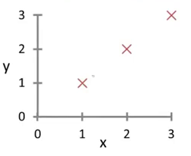




$$h_{θ}\left(x\right)$$
$$J\left(θ_{1}\right)$$
For fixed $θ_{1}$, this is a function of x
Function of the parameter $θ_{1}$

Slide 76


$$h_{θ}\left(x\right)$$
$$J\left(θ_{1}\right)$$
For fixed $θ_{1}$, this is a function of x
Function of the parameter $θ_{1}$
$$h_{θ}\left(x\right)$$
$θ_{1}=1$

Slide 77
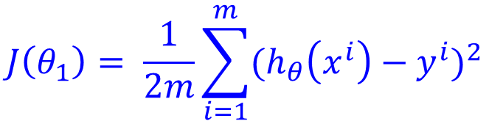
$$h_{θ}\left(x\right)$$
$$J\left(θ_{1}\right)$$
For fixed $θ_{1}$, this is a function of x
Function of the parameter $θ_{1}$
$$h_{θ}\left(x\right)$$
$θ_{1}=1$
$$J\left(θ_{1}\right)= \frac{1}{2m}\sum_{i=1}^{m}{{(h_{θ}\left(x^{i}\right)−y^{i})}^{2}}$$

Slide 78
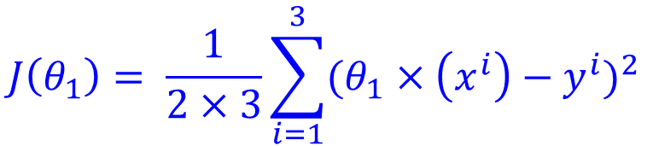
$$h_{θ}\left(x\right)$$
$$J\left(θ_{1}\right)$$
For fixed $θ_{1}$, this is a function of x
Function of the parameter $θ_{1}$
$$h_{θ}\left(x\right)$$
$θ_{1}=1$
$$J\left(θ_{1}\right)= \frac{1}{2×3}\sum_{i=1}^{3}{{(θ_{1}×\left(x^{i}\right)−y^{i})}^{2}}$$

Slide 79


$$h_{θ}\left(x\right)$$
$$J\left(θ_{1}\right)$$
For fixed $θ_{1}$, this is a function of x
Function of the parameter $θ_{1}$
$$h_{θ}\left(x\right)$$
$θ_{1}=1$
$$J\left(θ_{1}\right)= \frac{1}{2×3}\sum_{i=1}^{3}{{(θ_{1}×\left(x^{i}\right)−y^{i})}^{2}}$$
$$J\left(θ_{1}\right)= \frac{1}{2×3}\sum_{i=1}^{3}{{(θ_{1}×\left(x^{i}\right)−y^{i})}^{2}}$$

Slide 80

$$h_{θ}\left(x\right)$$
$$J\left(θ_{1}\right)$$
For fixed $θ_{1}$, this is a function of x
Function of the parameter $θ_{1}$
$$h_{θ}\left(x\right)$$
$θ_{1}=1$
$$J\left(θ_{1}\right)= \frac{1}{2×3}\sum_{i=1}^{3}{{(θ_{1}×\left(x^{i}\right)−y^{i})}^{2}}$$
$$J\left(θ_{1}\right)= \frac{1}{6}×{[(θ_{1}×1−1)}^{2}+{[(θ_{1}×2−2)}^{2}+{[(θ_{1}×3−3)}^{2}]$$

Slide 81
$$h_{θ}\left(x\right)$$
$$J\left(θ_{1}\right)$$
For fixed $θ_{1}$, this is a function of x
Function of the parameter $θ_{1}$
$$h_{θ}\left(x\right)$$
$θ_{1}=1$
$$J\left(θ_{1}\right)= \frac{1}{2×3}\sum_{i=1}^{3}{{(θ_{1}×\left(x^{i}\right)−y^{i})}^{2}}$$
$$J\left(θ_{1}\right)= \frac{1}{6}×{[(θ_{1}×1−1)}^{2}+{[(θ_{1}×2−2)}^{2}+{[(θ_{1}×3−3)}^{2}]$$
m = 1
m = 2
m = 3

Slide 82
$$h_{θ}\left(x\right)$$
$$J\left(θ_{1}\right)$$
For fixed $θ_{1}$, this is a function of x
Function of the parameter $θ_{1}$
$$h_{θ}\left(x\right)$$
$θ_{1}=1$
$$J\left(θ_{1}\right)= \frac{1}{2×3}\sum_{i=1}^{3}{{(θ_{1}×\left(x^{i}\right)−y^{i})}^{2}}$$
$$J\left(θ_{1}\right)= \frac{1}{6}×{[(1×1−1)}^{2}+{[(1×2−2)}^{2}+{[(1×3−3)}^{2}]$$
m = 1
m = 2
m = 3

Slide 83
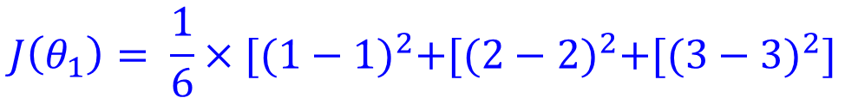
$$h_{θ}\left(x\right)$$
$$J\left(θ_{1}\right)$$
For fixed $θ_{1}$, this is a function of x
Function of the parameter $θ_{1}$
$$h_{θ}\left(x\right)$$
$θ_{1}=1$
$$J\left(θ_{1}\right)= \frac{1}{2×3}\sum_{i=1}^{3}{{(θ_{1}×\left(x^{i}\right)−y^{i})}^{2}}$$
$$J\left(θ_{1}\right)= \frac{1}{6}×{[(1−1)}^{2}+{[(2−2)}^{2}+{[(3−3)}^{2}]$$

Slide 84
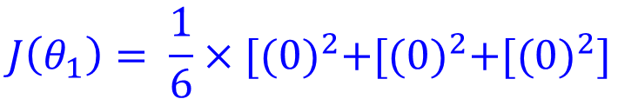
$$h_{θ}\left(x\right)$$
$$J\left(θ_{1}\right)$$
For fixed $θ_{1}$, this is a function of x
Function of the parameter $θ_{1}$
$$h_{θ}\left(x\right)$$
$θ_{1}=1$
$$J\left(θ_{1}\right)= \frac{1}{2×3}\sum_{i=1}^{3}{{(θ_{1}×\left(x^{i}\right)−y^{i})}^{2}}$$
$$J\left(θ_{1}\right)= \frac{1}{6}×{[(0)}^{2}+{[(0)}^{2}+{[(0)}^{2}]$$

Slide 85
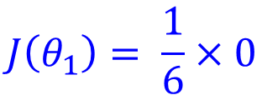
$$h_{θ}\left(x\right)$$
$$J\left(θ_{1}\right)$$
For fixed $θ_{1}$, this is a function of x
Function of the parameter $θ_{1}$
$$h_{θ}\left(x\right)$$
$θ_{1}=1$
$$J\left(θ_{1}\right)= \frac{1}{2×3}\sum_{i=1}^{3}{{(θ_{1}×\left(x^{i}\right)−y^{i})}^{2}}$$
$$J\left(θ_{1}\right)= \frac{1}{6}×0$$

Slide 86
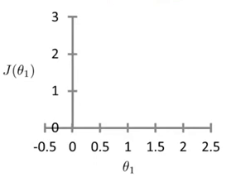

$$h_{θ}\left(x\right)$$
$$J\left(θ_{1}\right)$$
For fixed $θ_{1}$, this is a function of x
Function of the parameter $θ_{1}$
$$h_{θ}\left(x\right)$$
$θ_{1}=1$
$$J\left(θ_{1}\right)= \frac{1}{2×3}\sum_{i=1}^{3}{{(θ_{1}×\left(x^{i}\right)−y^{i})}^{2}}$$
$$J\left(θ_{1}\right)= 0$$

Slide 87

$$h_{θ}\left(x\right)$$
$$J\left(θ_{1}\right)$$
For fixed $θ_{1}$, this is a function of x
Function of the parameter $θ_{1}$
$$h_{θ}\left(x\right)$$
$θ_{1}=1$
$$J\left(θ_{1}\right)= \frac{1}{2×3}\sum_{i=1}^{3}{{(θ_{1}×\left(x^{i}\right)−y^{i})}^{2}}$$
$$J\left(θ_{1}\right)= 0$$

Slide 88
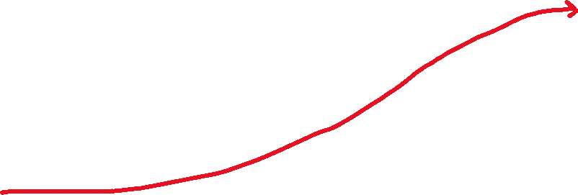
$$h_{θ}\left(x\right)$$
$$J\left(θ_{1}\right)$$
For fixed $θ_{1}$, this is a function of x
Function of the parameter $θ_{1}$
$$h_{θ}\left(x\right)$$
$θ_{1}=1$
$$J\left(θ_{1}\right)= \frac{1}{2×3}\sum_{i=1}^{3}{{(θ_{1}×\left(x^{i}\right)−y^{i})}^{2}}$$
$$J\left(θ_{1}\right)= 0$$

Slide 89
$$h_{θ}\left(x\right)$$
$$J\left(θ_{1}\right)$$
For fixed $θ_{1}$, this is a function of x
Function of the parameter $θ_{1}$
$$h_{θ}\left(x\right)$$
$θ_{1}=1$
$$J\left(θ_{1}\right)= \frac{1}{2×3}\sum_{i=1}^{3}{{(θ_{1}×\left(x^{i}\right)−y^{i})}^{2}}$$
$$J\left(θ_{1}\right)= 0$$

Slide 90
$$h_{θ}\left(x\right)$$
$$J\left(θ_{1}\right)$$
For fixed $θ_{1}$, this is a function of x
Function of the parameter $θ_{1}$
$$h_{θ}\left(x\right)$$
$θ_{1}=1$
$$J\left(θ_{1}\right)= \frac{1}{2×3}\sum_{i=1}^{3}{{(θ_{1}×\left(x^{i}\right)−y^{i})}^{2}}$$
$$J\left(θ_{1}\right)= 0$$

Slide 91


$$h_{θ}\left(x\right)$$
$$J\left(θ_{1}\right)$$
For fixed $θ_{1}$, this is a function of x
Function of the parameter $θ_{1}$
$$h_{θ}\left(x\right)$$
$θ_{1}=0.5$
$$J\left(θ_{1}\right)= \frac{1}{2×3}\sum_{i=1}^{3}{{(θ_{1}×\left(x^{i}\right)−y^{i})}^{2}}$$

Slide 92
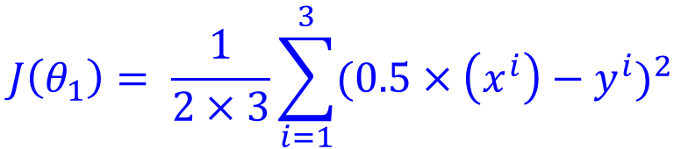

$$h_{θ}\left(x\right)$$
$$J\left(θ_{1}\right)$$
For fixed $θ_{1}$, this is a function of x
Function of the parameter $θ_{1}$
$$h_{θ}\left(x\right)$$
$θ_{1}=0.5$
$$J\left(θ_{1}\right)= \frac{1}{2×3}\sum_{i=1}^{3}{{(0.5×\left(x^{i}\right)−y^{i})}^{2}}$$

Slide 93

$$h_{θ}\left(x\right)$$
$$J\left(θ_{1}\right)$$
For fixed $θ_{1}$, this is a function of x
Function of the parameter $θ_{1}$
$$h_{θ}\left(x\right)$$
$θ_{1}=0.5$
$$J\left(θ_{1}\right)= \frac{1}{2×3}\sum_{i=1}^{3}{{(0.5×\left(x^{i}\right)−y^{i})}^{2}}$$

Slide 94


$$h_{θ}\left(x\right)$$
$$J\left(θ_{1}\right)$$
For fixed $θ_{1}$, this is a function of x
Function of the parameter $θ_{1}$
$$y^{i}$$
$$h_{θ}\left(x\right)$$
$θ_{1}=0.5$
$$J\left(θ_{1}\right)= \frac{1}{2×3}\sum_{i=1}^{3}{{(0.5×\left(x^{i}\right)−y^{i})}^{2}}$$

Slide 95

$$h_{θ}\left(x\right)$$
$$J\left(θ_{1}\right)$$
For fixed $θ_{1}$, this is a function of x
Function of the parameter $θ_{1}$
$$y^{i}$$
$$h_{θ}\left(x\right)$$
$θ_{1}=0.5$
$$h_{θ}(x^{i})$$
$$J\left(θ_{1}\right)= \frac{1}{2×3}\sum_{i=1}^{3}{{(0.5×\left(x^{i}\right)−y^{i})}^{2}}$$

Slide 96
$$h_{θ}\left(x\right)$$
$$J\left(θ_{1}\right)$$
For fixed $θ_{1}$, this is a function of x
Function of the parameter $θ_{1}$
$$y^{i}$$
$$h_{θ}\left(x\right)$$
$θ_{1}=0.5$
$$h_{θ}(x^{i})$$
$$J\left(θ_{1}\right)= \frac{1}{2×3}\sum_{i=1}^{3}{{(0.5×\left(x^{i}\right)−y^{i})}^{2}}$$
$$J\left(θ_{1}\right)= \frac{1}{6}[{\left(0.5×1−1\right)}^{2}+{\left(0.5×2−2\right)}^{2}+{\left(0.5×3−3\right)}^{2}]$$

Slide 97

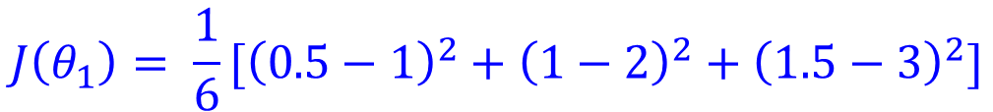
$$h_{θ}\left(x\right)$$
$$J\left(θ_{1}\right)$$
For fixed $θ_{1}$, this is a function of x
Function of the parameter $θ_{1}$
$$y^{i}$$
$$h_{θ}\left(x\right)$$
$θ_{1}=0.5$
$$h_{θ}(x^{i})$$
$$J\left(θ_{1}\right)= \frac{1}{2×3}\sum_{i=1}^{3}{{(θ_{1}×\left(x^{i}\right)−y^{i})}^{2}}$$
$$J\left(θ_{1}\right)= \frac{1}{6}[{\left(0.5−1\right)}^{2}+{\left(1−2\right)}^{2}+{\left(1.5−3\right)}^{2}]$$

Slide 98

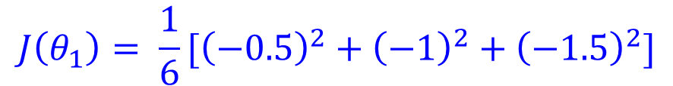
$$h_{θ}\left(x\right)$$
$$J\left(θ_{1}\right)$$
For fixed $θ_{1}$, this is a function of x
Function of the parameter $θ_{1}$
$$y^{i}$$
$$h_{θ}\left(x\right)$$
$θ_{1}=0.5$
$$h_{θ}(x^{i})$$
$$J\left(θ_{1}\right)= \frac{1}{2×3}\sum_{i=1}^{3}{{(θ_{1}×\left(x^{i}\right)−y^{i})}^{2}}$$
$$J\left(θ_{1}\right)= \frac{1}{6}[{\left(−0.5\right)}^{2}+{\left(−1\right)}^{2}+{\left(−1.5\right)}^{2}]$$

Slide 99


$$h_{θ}\left(x\right)$$
$$J\left(θ_{1}\right)$$
For fixed $θ_{1}$, this is a function of x
Function of the parameter $θ_{1}$
$$y^{i}$$
$$h_{θ}\left(x\right)$$
$θ_{1}=0.5$
$$h_{θ}(x^{i})$$
$$J\left(θ_{1}\right)= \frac{1}{2×3}\sum_{i=1}^{3}{{(θ_{1}×\left(x^{i}\right)−y^{i})}^{2}}$$
$$J\left(θ_{1}\right)= \frac{1}{6}[0.25+1+2.25]$$

Slide 100


$$h_{θ}\left(x\right)$$
$$J\left(θ_{1}\right)$$
For fixed $θ_{1}$, this is a function of x
Function of the parameter $θ_{1}$
$$y^{i}$$
$$h_{θ}\left(x\right)$$
$θ_{1}=0.5$
$$h_{θ}(x^{i})$$
$$J\left(θ_{1}\right)= \frac{1}{2×3}\sum_{i=1}^{3}{{(θ_{1}×\left(x^{i}\right)−y^{i})}^{2}}$$
$$J\left(θ_{1}\right)= \frac{1}{6}[3.5]$$

Slide 101


$$h_{θ}\left(x\right)$$
$$J\left(θ_{1}\right)$$
For fixed $θ_{1}$, this is a function of x
Function of the parameter $θ_{1}$
$$y^{i}$$
$$h_{θ}\left(x\right)$$
$θ_{1}=0.5$
$$h_{θ}(x^{i})$$
$$J\left(θ_{1}\right)= \frac{1}{2×3}\sum_{i=1}^{3}{{(θ_{1}×\left(x^{i}\right)−y^{i})}^{2}}$$
$$J\left(θ_{1}\right)=0.58$$

Slide 102



$$h_{θ}\left(x\right)$$
$$J\left(θ_{1}\right)$$
For fixed $θ_{1}$, this is a function of x
Function of the parameter $θ_{1}$
$$y^{i}$$
$$h_{θ}\left(x\right)$$
$θ_{1}=0.5$
$$h_{θ}(x^{i})$$
$$J\left(θ_{1}\right)= \frac{1}{2×3}\sum_{i=1}^{3}{{(θ_{1}×\left(x^{i}\right)−y^{i})}^{2}}$$
$$J\left(θ_{1}\right)=0.58$$

Slide 103



$$h_{θ}\left(x\right)$$
$$J\left(θ_{1}\right)$$
For fixed $θ_{1}$, this is a function of x
Function of the parameter $θ_{1}$
$$y^{i}$$
$$h_{θ}\left(x\right)$$
$θ_{1}=0.5$
$$h_{θ}(x^{i})$$
$$J\left(θ_{1}\right)= \frac{1}{2×3}\sum_{i=1}^{3}{{(θ_{1}×\left(x^{i}\right)−y^{i})}^{2}}$$
$$J\left(θ_{1}\right)=0.58$$

Slide 104


$$h_{θ}\left(x\right)$$
$$J\left(θ_{1}\right)$$
For fixed $θ_{1}$, this is a function of x
Function of the parameter $θ_{1}$
$$y^{i}$$
$$h_{θ}\left(x\right)$$
$θ_{1}=0.5$
$$h_{θ}(x^{i})$$
$$J\left(θ_{1}\right)= \frac{1}{2×3}\sum_{i=1}^{3}{{(θ_{1}×\left(x^{i}\right)−y^{i})}^{2}}$$
$$J\left(θ_{1}\right)=0.58$$

Slide 105


$$h_{θ}\left(x\right)$$
$$J\left(θ_{1}\right)$$
For fixed $θ_{1}$, this is a function of x
Function of the parameter $θ_{1}$
$$y^{i}$$
$$h_{θ}\left(x\right)$$
$θ_{1}=0.5$
$$h_{θ}(x^{i})$$
$$J\left(θ_{1}\right)= \frac{1}{2×3}\sum_{i=1}^{3}{{(θ_{1}×\left(x^{i}\right)−y^{i})}^{2}}$$
$$J\left(θ_{1}\right)=0.58$$

Slide 106

$$h_{θ}\left(x\right)$$
$$J\left(θ_{1}\right)$$
For fixed $θ_{1}$, this is a function of x
Function of the parameter $θ_{1}$
$θ_{1}=0$
$$J\left(θ_{1}\right)= \frac{1}{2×3}\sum_{i=1}^{3}{{(θ_{1}×\left(x^{i}\right)−y^{i})}^{2}}$$

Slide 107
$$h_{θ}\left(x\right)$$
$$J\left(θ_{1}\right)$$
For fixed $θ_{1}$, this is a function of x
Function of the parameter $θ_{1}$
$θ_{1}=0$
$$J\left(θ_{1}\right)= \frac{1}{2×3}\sum_{i=1}^{3}{{(θ_{1}×\left(x^{i}\right)−y^{i})}^{2}}$$

Slide 108

$$h_{θ}\left(x\right)$$
$$J\left(θ_{1}\right)$$
For fixed $θ_{1}$, this is a function of x
Function of the parameter $θ_{1}$
$θ_{1}=0$
$$J\left(θ_{1}\right)= \frac{1}{2×3}\sum_{i=1}^{3}{{(θ_{1}×\left(x^{i}\right)−y^{i})}^{2}}$$
$$J\left(θ_{1}\right)= \frac{1}{6}[{\left(1\right)}^{2}+{\left(2\right)}^{2}+{\left(3\right)}^{2}]$$

Slide 109

$$h_{θ}\left(x\right)$$
$$J\left(θ_{1}\right)$$
For fixed $θ_{1}$, this is a function of x
Function of the parameter $θ_{1}$
$θ_{1}=0$
$$J\left(θ_{1}\right)= \frac{1}{2×3}\sum_{i=1}^{3}{{(θ_{1}×\left(x^{i}\right)−y^{i})}^{2}}$$
$$J\left(θ_{1}\right)= \frac{1}{6}[1+4+9]$$

Slide 110

$$h_{θ}\left(x\right)$$
$$J\left(θ_{1}\right)$$
For fixed $θ_{1}$, this is a function of x
Function of the parameter $θ_{1}$
$θ_{1}=0$
$$J\left(θ_{1}\right)= \frac{1}{2×3}\sum_{i=1}^{3}{{(θ_{1}×\left(x^{i}\right)−y^{i})}^{2}}$$
$$J\left(θ_{1}\right)= \frac{1}{6}[14]$$

Slide 111

$$h_{θ}\left(x\right)$$
$$J\left(θ_{1}\right)$$
For fixed $θ_{1}$, this is a function of x
Function of the parameter $θ_{1}$
$θ_{1}=0$
$$J\left(θ_{1}\right)= \frac{1}{2×3}\sum_{i=1}^{3}{{(θ_{1}×\left(x^{i}\right)−y^{i})}^{2}}$$
$$J\left(θ_{1}\right)=2.3$$

Slide 112


$$h_{θ}\left(x\right)$$
$$J\left(θ_{1}\right)$$
For fixed $θ_{1}$, this is a function of x
Function of the parameter $θ_{1}$
$θ_{1}=0$
$$J\left(θ_{1}\right)= \frac{1}{2×3}\sum_{i=1}^{3}{{(θ_{1}×\left(x^{i}\right)−y^{i})}^{2}}$$
$$J\left(θ_{1}\right)=2.3$$

Slide 113
$$h_{θ}\left(x\right)$$
$$J\left(θ_{1}\right)$$
For fixed $θ_{1}$, this is a function of x
Function of the parameter $θ_{1}$
$θ_{1}=0$
$$J\left(θ_{1}\right)= \frac{1}{2×3}\sum_{i=1}^{3}{{(θ_{1}×\left(x^{i}\right)−y^{i})}^{2}}$$
$$J\left(θ_{1}\right)=2.3$$

Slide 114
$$h_{θ}\left(x\right)$$
$$J\left(θ_{1}\right)$$
For fixed $θ_{1}$, this is a function of x
Function of the parameter $θ_{1}$
$θ_{1}=0$
$$J\left(θ_{1}\right)= \frac{1}{2×3}\sum_{i=1}^{3}{{(θ_{1}×\left(x^{i}\right)−y^{i})}^{2}}$$
$$J\left(θ_{1}\right)=2.3$$

Slide 115
$$h_{θ}\left(x\right)$$
$$J\left(θ_{1}\right)$$
For fixed $θ_{1}$, this is a function of x
Function of the parameter $θ_{1}$
$θ_{1}=0$
$$J\left(θ_{1}\right)= \frac{1}{2×3}\sum_{i=1}^{3}{{(θ_{1}×\left(x^{i}\right)−y^{i})}^{2}}$$
$$J\left(θ_{1}\right)=2.3$$

Slide 116
$$h_{θ}\left(x\right)$$
$$J\left(θ_{1}\right)$$
For fixed $θ_{1}$, this is a function of x
Function of the parameter $θ_{1}$
$θ_{1}=0$
$$J\left(θ_{1}\right)= \frac{1}{2×3}\sum_{i=1}^{3}{{(θ_{1}×\left(x^{i}\right)−y^{i})}^{2}}$$
$$J\left(θ_{1}\right)=2.3$$

Slide 117

$$h_{θ}\left(x\right)$$
$$J\left(θ_{1}\right)$$
For fixed $θ_{1}$, this is a function of x
Function of the parameter $θ_{1}$
$θ_{1}=0$
$$J\left(θ_{1}\right)= \frac{1}{2×3}\sum_{i=1}^{3}{{(θ_{1}×\left(x^{i}\right)−y^{i})}^{2}}$$
$$J\left(θ_{1}\right)=2.3$$

Slide 119


Slide 120


Slide 121

$$θ_{0}=50$$
$$θ_{1}=0.06$$

Slide 122

$$θ_{0}=50$$
$$θ_{1}=0.06$$
Previously when there was one parameter

Slide 123

Now, we have two parameters, $θ_{0}$ and $θ_{1}$
$$θ_{0}=50$$
$$θ_{1}=0.06$$

Slide 124


$$θ_{0}=50$$
$$θ_{1}=0.06$$
Now, we have two parameters, $θ_{0}$ and $θ_{1}$S

Slide 125


Slide 126


$$θ_{0}=50$$
$$θ_{1}=0.06$$
Now, we have two parameters, $θ_{0}$ and $θ_{1}$

Slide 127

same value of J
$$θ_{0}=50$$
$$θ_{1}=0.06$$
Now, we have two parameters, $θ_{0}$ and $θ_{1}$

Slide 128
$$θ_{0}=50$$
$$θ_{1}=0.06$$
Now, we have two parameters, $θ_{0}$ and $θ_{1}$

Slide 129
$$θ_{0}=50$$
$$θ_{1}=0.06$$
-1.5
800
Now, we have two parameters, $θ_{0}$ and $θ_{1}$

Slide 130

$$θ_{0}=50$$
$$θ_{1}=0.06$$
$$θ_{0}=800$$
$$θ_{1}=−1.5$$
-1.5
800
Now, we have two parameters, $θ_{0}$ and $θ_{1}$

Slide 131

h(x)$=$800 - 1.5 $×$x
$$θ_{0}=50$$
$$θ_{1}=0.06$$
$$θ_{0}=800$$
$$θ_{1}=−1.5$$
-1.5
800
Now, we have two parameters, $θ_{0}$ and $θ_{1}$

Slide 132

Now, we have two parameters, $θ_{0}$ and $θ_{1}$

Slide 133

0
$$θ_{0}=360$$
$$θ_{1}=0$$
360
Now, we have two parameters, $θ_{0}$ and $θ_{1}$

Slide 134

h(x)$=$360 + 0 $×$x
0
$$θ_{0}=360$$
$$θ_{1}=0$$
360
Now, we have two parameters, $θ_{0}$ and $θ_{1}$

Slide 135


Slide 137


Slide 140
Linear Regression – Gradient Descent

Slide 141

Have some function $J\left(θ_{0},θ_{1}\right)$
Want $\min_{θ_{0},θ_{1}}{J\left(θ_{0},θ_{1}\right)}$
Outline:
Start with some $θ_{0},θ_{1}$
Keep changing $θ_{0},θ_{1}$ to reduce $J\left(θ_{0},θ_{1}\right)$
until we hopefully end up at a minimum

Slide 142


Have some function $J\left(θ_{0},θ_{1}\right)$
Want $\min_{θ_{0},θ_{1}}{J\left(θ_{0},θ_{1}\right)}$
Outline:
Start with some $θ_{0},θ_{1}$
Keep changing $θ_{0},θ_{1}$ to reduce $J\left(θ_{0},θ_{1}\right)$
until we hopefully end up at a minimum
$J(θ_{0},θ_{1}$, $θ_{2},θ_{3},…,θ_{n})$
$$\min_{θ_{0},θ_{1}\text{, }θ_{2},,…,θ_{n}}{J(θ_{0},θ_{1}\text{, }θ_{2},θ_{3},…,θ_{n}) }$$

Slide 143




$$J\left(θ_{0},θ_{1}\right)$$
$$θ_{1}$$
$$θ_{0}$$

Slide 144
$$J\left(θ_{0},θ_{1}\right)$$
$$θ_{1}$$
$$θ_{0}$$

Slide 145
$$J\left(θ_{0},θ_{1}\right)$$
$$θ_{1}$$
$$θ_{0}$$

Slide 146
$$J\left(θ_{0},θ_{1}\right)$$
$$θ_{1}$$
$$θ_{0}$$

Slide 147
$$J\left(θ_{0},θ_{1}\right)$$
$$θ_{1}$$
$$θ_{0}$$

Slide 148
$$J\left(θ_{0},θ_{1}\right)$$
$$θ_{1}$$
$$θ_{0}$$

Slide 149
$$J\left(θ_{0},θ_{1}\right)$$
$$θ_{1}$$
$$θ_{0}$$

Slide 150
$$J\left(θ_{0},θ_{1}\right)$$
$$θ_{1}$$
$$θ_{0}$$

Slide 151
$$J\left(θ_{0},θ_{1}\right)$$
$$θ_{1}$$
$$θ_{0}$$

Slide 152
$$J\left(θ_{0},θ_{1}\right)$$
$$θ_{1}$$
$$θ_{0}$$

Slide 153
$$J\left(θ_{0},θ_{1}\right)$$
$$θ_{1}$$
$$θ_{0}$$

Slide 154
$$J\left(θ_{0},θ_{1}\right)$$
$$θ_{1}$$
$$θ_{0}$$

Slide 155
$$J\left(θ_{0},θ_{1}\right)$$
$$θ_{1}$$
$$θ_{0}$$

Slide 156
$$J\left(θ_{0},θ_{1}\right)$$
$$θ_{1}$$
$$θ_{0}$$

Slide 157
$$J\left(θ_{0},θ_{1}\right)$$
$$θ_{1}$$
$$θ_{0}$$

Slide 158
$$J\left(θ_{0},θ_{1}\right)$$
$$θ_{1}$$
$$θ_{0}$$

Slide 159
$$J\left(θ_{0},θ_{1}\right)$$
$$θ_{1}$$
$$θ_{0}$$

Slide 160
$$J\left(θ_{0},θ_{1}\right)$$
$$θ_{1}$$
$$θ_{0}$$

Slide 161

Gradient descent algorithm
Repeat until convergence {
${ θ}_{j}≔$ $θ_{j}− α \frac{∂}{∂θ_{j}}$ $J\left(θ_{0},θ_{1}\right)$ (for j=0 and j=1)
}

Slide 162

Gradient descent algorithm
Repeat until convergence {
${ θ}_{j}≔$ $θ_{j}− α \frac{∂}{∂θ_{j}}$ $J\left(θ_{0},θ_{1}\right)$ (for j=0 and j=1)
}
Correct: Simultaneous update
temp0 $≔θ_{0}$ $− α \frac{∂}{∂θ_{j}}$ $J\left(θ_{0},θ_{1}\right)$
temp1 $≔θ_{1}$ $− α \frac{∂}{∂θ_{j}}$ $J\left(θ_{0},θ_{1}\right)$
$θ_{0}$ $≔$ temp0
$θ_{1}$ $≔$ temp1

Slide 163

Gradient descent algorithm
Repeat until convergence {
${ θ}_{j}≔$ $θ_{j}− α \frac{∂}{∂θ_{j}}$ $J\left(θ_{0},θ_{1}\right)$ (for j=0 and j=1)
}
Correct: Simultaneous update Incorrect
temp0 $≔θ_{0}$ $− α \frac{∂}{∂θ_{j}}$ $J\left(θ_{0},θ_{1}\right)$ temp0 $≔θ_{0}$ $− α \frac{∂}{∂θ_{j}}$ $J\left(θ_{0},θ_{1}\right)$
temp1 $≔θ_{1}$ $− α \frac{∂}{∂θ_{j}}$ $J\left(θ_{0},θ_{1}\right)$ ${ θ}_{0}$ $≔$ temp0
$θ_{0}$ $≔$ temp0 temp1 $≔θ_{1}$ $− α \frac{∂}{∂θ_{j}}$ $J\left(θ_{0},θ_{1}\right)$
$θ_{1}$ $≔$ temp1 $θ_{1}$ $≔$ temp1

Slide 164

Gradient descent algorithm
Repeat until convergence {
${ θ}_{j}≔$ $θ_{j}− α \frac{∂}{∂θ_{j}}$ $J\left(θ_{0},θ_{1}\right)$ (Simultaneously update
j=0 and j=1)
}
Derivative

Slide 165
Gradient descent algorithm
Repeat until convergence {
${ θ}_{j}≔$ $θ_{j}− α \frac{∂}{∂θ_{j}}$ $J\left(θ_{0},θ_{1}\right)$ (Simultaneously update
j=0 and j=1)
}
Learning rate
Derivative

Slide 166


$$J\left(θ_{1}\right)$$
$$θ_{1}$$

Slide 167

$$J\left(θ_{1}\right)$$
$$θ_{1}$$
$$θ_{1}$$

Slide 168

$$J\left(θ_{1}\right)$$
${ θ}_{1}≔$ $θ_{1}− α \frac{∂}{∂θ_{1}}$ $J\left(θ_{1}\right)$
$$θ_{1}$$
$$θ_{1}$$

Slide 169

$$J\left(θ_{1}\right)$$
${ θ}_{1}≔$ $θ_{1}− α \frac{∂}{∂θ_{1}}$ $J\left(θ_{1}\right)$
$$θ_{1}$$
slope @ $θ_{1}$
$$θ_{1}$$

Slide 170

$$J\left(θ_{1}\right)$$
${ θ}_{1}≔$ $θ_{1}− α \frac{∂}{∂θ_{1}}$ $J\left(θ_{1}\right)$
$$θ_{1}$$
slope @ $θ_{1}$
$$θ_{1}$$
Slope = $\frac{RISE}{RUN}$

Slide 171
$$J\left(θ_{1}\right)$$
${ θ}_{1}≔$ $θ_{1}− α \frac{∂}{∂θ_{1}}$ $J\left(θ_{1}\right)$
RISE is +ve
RUN is +ve
slope @ $θ_{1}$
$$θ_{1}$$
$$θ_{1}$$
Slope = $\frac{RISE}{RUN}$

Slide 172

$$J\left(θ_{1}\right)$$
${ θ}_{1}≔$ $θ_{1}− α \frac{∂}{∂θ_{1}}$ $J\left(θ_{1}\right)$
RISE is +ve
RUN is +ve
slope @ $θ_{1}$
$$θ_{1}$$
$$θ_{1}$$
Slope = $\frac{+ve}{+ve}=+ve$

Slide 173


$$J\left(θ_{1}\right)$$
RISE is -ve
${ θ}_{1}≔$ $θ_{1}− α \frac{∂}{∂θ_{1}}$ $J\left(θ_{1}\right)$
RUN is -ve
slope @ $θ_{1}$
$$θ_{1}$$
$$θ_{1}$$
Slope = $\frac{−ve}{−ve}=+ve$

Slide 174

$$J\left(θ_{1}\right)$$
${ θ}_{1}≔$ $θ_{1}− α \frac{∂}{∂θ_{1}}$ $J\left(θ_{1}\right)$
Positive Slope
$$θ_{1}$$
slope @ $θ_{1}$
$$θ_{1}$$
+ve
${ θ}_{1}≔$ $θ_{1}− α \left(+ve\right)$

Slide 175

$$J\left(θ_{1}\right)$$
${ θ}_{1}≔$ $θ_{1}− α \frac{∂}{∂θ_{1}}$ $J\left(θ_{1}\right)$
$$θ_{1}$$
slope @ $θ_{1}$
$$θ_{1}$$
+ve
${ θ}_{1}≔$ $θ_{1}− α \left(+ve\right)$
${ θ}_{1}≔$ $θ_{1}− \left(+ve\right)$

Slide 176

$$J\left(θ_{1}\right)$$
${ θ}_{1}≔$ $θ_{1}− α \frac{∂}{∂θ_{1}}$ $J\left(θ_{1}\right)$
$$θ_{1}$$
slope @ $θ_{1}$
$$θ_{1}$$
+ve
${ θ}_{1}≔$ $θ_{1}− α \left(+ve\right)$
${ θ}_{1}≔$ $θ_{1}− \left(+ve\right)$
$${ θ}_{1}<θ_{1}(previous)$$

Slide 177


$$J\left(θ_{1}\right)$$
${ θ}_{1}≔$ $θ_{1}− α \frac{∂}{∂θ_{1}}$ $J\left(θ_{1}\right)$
$$θ_{1}$$
slope @ $θ_{1}$
$$θ_{1}$$
$$θ_{1}$$
+ve
updated
previous
${ θ}_{1}≔$ $θ_{1}− α \left(+ve\right)$
${ θ}_{1}≔$ $θ_{1}− \left(+ve\right)$
$${ θ}_{1}<θ_{1}(previous)$$

Slide 178

$$J\left(θ_{1}\right)$$
${ θ}_{1}≔$ $θ_{1}− α \frac{∂}{∂θ_{1}}$ $J\left(θ_{1}\right)$
Negative Slope
$$θ_{1}$$
slope @ $θ_{1}$
$$θ_{1}$$

Slide 179
$$J\left(θ_{1}\right)$$
${ θ}_{1}≔$ $θ_{1}− α \frac{∂}{∂θ_{1}}$ $J\left(θ_{1}\right)$
Negative Slope
$$θ_{1}$$
slope @ $θ_{1}$
$$θ_{1}$$
-ve

Slide 180

$$J\left(θ_{1}\right)$$
${ θ}_{1}≔$ $θ_{1}− α \frac{∂}{∂θ_{1}}$ $J\left(θ_{1}\right)$
Negative Slope
$$θ_{1}$$
slope @ $θ_{1}$
$$θ_{1}$$
-ve
${ θ}_{1}≔$ $θ_{1}− α \left(−ve\right)$

Slide 181

$$J\left(θ_{1}\right)$$
${ θ}_{1}≔$ $θ_{1}− α \frac{∂}{∂θ_{1}}$ $J\left(θ_{1}\right)$
Negative Slope
$$θ_{1}$$
slope @ $θ_{1}$
$$θ_{1}$$
-ve
${ θ}_{1}≔$ $θ_{1}− α \left(−ve\right)$
${ θ}_{1}≔$ $θ_{1}− \left(−ve\right)$

Slide 182



$$J\left(θ_{1}\right)$$
${ θ}_{1}≔$ $θ_{1}− α \frac{∂}{∂θ_{1}}$ $J\left(θ_{1}\right)$
Negative Slope
$$θ_{1}$$
slope @ $θ_{1}$
$$θ_{1}$$
$$θ_{1}$$
-ve
previous
updated
${ θ}_{1}≔$ $θ_{1}− α \left(−ve\right)$
${ θ}_{1}≔$ $θ_{1}− \left(−ve\right)$
$${ θ}_{1}>θ_{1}(previous)$$

Slide 183


$θ_{1}≔$ $θ_{1}− α \frac{∂}{∂θ_{1}}$ $J\left(θ_{1}\right)$
If $∝$ is too small, gradient descent can be slow
If $∝$ is too large, gradient descent can overshoot
the minimum. It may fail to converge, or even
Diverge.

Slide 184


Slide 185


Slide 186


Slide 187
$\frac{∂}{∂θ_{j}}$ $J\left(θ_{0},θ_{1}\right)=\frac{∂}{∂θ_{j}}$ $× \frac{1}{2m}\sum_{i=1}^{m}{{(h_{θ}(x^{(i)})−y^{(i)})}^{2}}$

Slide 188

$\frac{∂}{∂θ_{j}}$ $J\left(θ_{0},θ_{1}\right)=\frac{∂}{∂θ_{j}}$ $× \frac{1}{2m}\sum_{i=1}^{m}{{(h_{θ}(x^{(i)})−y^{(i)})}^{2}}$
$= \frac{∂}{∂θ_{j}}$ $× \frac{1}{2m}\sum_{i=1}^{m}{{(θ_{0}+θ_{1}. x^{(i)}−y^{(i)})}^{2}}$

Slide 189

$\frac{∂}{∂θ_{j}}$ $J\left(θ_{0},θ_{1}\right)=\frac{∂}{∂θ_{j}}$ $× \frac{1}{2m}\sum_{i=1}^{m}{{(h_{θ}(x^{(i)})−y^{(i)})}^{2}}$
$= \frac{1}{2m}×\frac{∂}{∂θ_{j}}\sum_{i=1}^{m}{{(θ_{0}+θ_{1}. x^{(i)}−y^{(i)})}^{2}}$

Slide 190
$\frac{∂}{∂θ_{j}}$ $J\left(θ_{0},θ_{1}\right)=\frac{∂}{∂θ_{j}}$ $× \frac{1}{2m}\sum_{i=1}^{m}{{(h_{θ}(x^{(i)})−y^{(i)})}^{2}}$
$= \frac{1}{2m}×\frac{∂}{∂θ_{j}}\sum_{i=1}^{m}{{(θ_{0}+θ_{1}. x^{(i)}−y^{(i)})}^{2}}$
$θ_{0} j=0 :\frac{∂}{ ∂θ_{0}} J\left(θ_{0},θ_{1}\right)=$ $\frac{1}{m}\sum_{i=1}^{m}{(h_{θ}(x^{(i)})−y^{(i)})}$

Slide 191

$\frac{∂}{∂θ_{1}}$ $J\left(θ_{0},θ_{1}\right)=\frac{∂}{∂θ_{1}}$ $× \frac{1}{2m}\sum_{i=1}^{m}{{(h_{θ}(x^{(i)})−y^{(i)})}^{2}}$
$= \frac{1}{2m}×\frac{∂}{∂θ_{1}}\sum_{i=1}^{m}{{(θ_{0}+θ_{1}. x^{(i)}−y^{(i)})}^{2}}$
$θ_{0} j=0 :\frac{∂}{ ∂θ_{0}} J\left(θ_{0},θ_{1}\right)=$ $\frac{1}{m}\sum_{i=1}^{m}{(h_{θ}(x^{(i)})−y^{(i)})}$
$θ_{1} j=1 :\frac{∂}{ ∂θ_{1}} J\left(θ_{0},θ_{1}\right)=\frac{1}{m}\sum_{i=1}^{m}{(h_{θ}(x^{(i)})−y^{(i)})}$ . $x^{(i)}$

Slide 192
Gradient descent algorithm
Repeat until convergence {
${ θ}_{j}≔$ $θ_{j}− α \frac{∂}{∂θ_{j}}$ $J\left(θ_{0},θ_{1}\right)$ (Simultaneously update
j=0 and j=1)
}

Slide 193

Gradient descent algorithm
Repeat until convergence {
${ θ}_{0}≔$ $θ_{0}− α \frac{∂}{∂θ_{0}}$ $J\left(θ_{0},θ_{1}\right)$
${ θ}_{1}≔$ $θ_{1}− α \frac{∂}{∂θ_{1}}$ $J\left(θ_{0},θ_{1}\right)$
}

Slide 194

Gradient descent algorithm
Repeat until convergence {
${ θ}_{0}≔$ $θ_{0}− α \frac{∂}{∂θ_{0}}$ $J\left(θ_{0},θ_{1}\right)$
${ θ}_{1}≔$ $θ_{1}− α \frac{∂}{∂θ_{1}}$ $J\left(θ_{0},θ_{1}\right)$
}
$θ_{0} j=0 :\frac{∂}{ ∂θ_{0}} J\left(θ_{0},θ_{1}\right)=$ $\frac{1}{m}\sum_{i=1}^{m}{(h_{θ}(x^{(i)})−y^{(i)})}$

Slide 195

Gradient descent algorithm
Repeat until convergence {
${ θ}_{0}≔$ $θ_{0}− α\frac{1}{m}\sum_{i=1}^{m}{(h_{θ}(x^{(i)})−y^{(i)})}$
${ θ}_{1}≔$ $θ_{1}− α \frac{∂}{∂θ_{1}}$ $J\left(θ_{0},θ_{1}\right)$
}
$θ_{0} j=0 :\frac{∂}{ ∂θ_{0}} J\left(θ_{0},θ_{1}\right)=$ $\frac{1}{m}\sum_{i=1}^{m}{(h_{θ}(x^{(i)})−y^{(i)})}$

Slide 196

Gradient descent algorithm
Repeat until convergence {
${ θ}_{0}≔$ $θ_{0}− α\frac{1}{m}\sum_{i=1}^{m}{(h_{θ}(x^{(i)})−y^{(i)})}$
${ θ}_{1}≔$ $θ_{1}− α \frac{∂}{∂θ_{1}}$ $J\left(θ_{0},θ_{1}\right)$
}
$θ_{0} j=0 :\frac{∂}{ ∂θ_{0}} J\left(θ_{0},θ_{1}\right)=$ $\frac{1}{m}\sum_{i=1}^{m}{(h_{θ}(x^{(i)})−y^{(i)})}$
$θ_{1} j=1 :\frac{∂}{ ∂θ_{1}} J\left(θ_{0},θ_{1}\right)=\frac{1}{m}\sum_{i=1}^{m}{(h_{θ}(x^{(i)})−y^{(i)})}$ . $x^{(i)}$

Slide 197

Gradient descent algorithm
Repeat until convergence {
${ θ}_{0}≔$ $θ_{0}− α\frac{1}{m}\sum_{i=1}^{m}{(h_{θ}(x^{(i)})−y^{(i)})}$
${ θ}_{1}≔$ $θ_{1}− α\frac{1}{m}\sum_{i=1}^{m}{(h_{θ}(x^{(i)})−y^{(i)})}\text{ . }x^{(i)}$
}
$θ_{0} j=0 :\frac{∂}{ ∂θ_{0}} J\left(θ_{0},θ_{1}\right)=$ $\frac{1}{m}\sum_{i=1}^{m}{(h_{θ}(x^{(i)})−y^{(i)})}$
$θ_{1} j=1 :\frac{∂}{ ∂θ_{1}} J\left(θ_{0},θ_{1}\right)=\frac{1}{m}\sum_{i=1}^{m}{(h_{θ}(x^{(i)})−y^{(i)})}$ . $x^{(i)}$

Slide 198

Gradient descent algorithm
Repeat until convergence {
${ θ}_{0}≔$ $θ_{0}− α\frac{1}{m}\sum_{i=1}^{m}{(h_{θ}(x^{(i)})−y^{(i)})}$
${ θ}_{1}≔$ $θ_{1}− α\frac{1}{m}\sum_{i=1}^{m}{(h_{θ}(x^{(i)})−y^{(i)})}\text{ . }x^{(i)}$
}

Slide 199

Gradient descent algorithm
Repeat until convergence {
${ θ}_{0}≔$ $θ_{0}− α\frac{1}{m}\sum_{i=1}^{m}{(h_{θ}(x^{(i)})−y^{(i)})}$
${ θ}_{1}≔$ $θ_{1}− α\frac{1}{m}\sum_{i=1}^{m}{(h_{θ}(x^{(i)})−y^{(i)})}\text{ . }x^{(i)}$
}
Update
$θ_{0}$ and $θ_{1}$
simultaneously

Slide 200




The loss function of
a Linear Regression
is always a
CONVEX FUNCTION
$$J\left(θ_{0},θ_{1}\right)$$
$$θ_{1}$$
$$θ_{0}$$

Slide 201


Slide 202


Slide 203


Slide 204


Slide 205


Slide 206


Slide 207


Slide 208


Slide 209


